Slide 1
Simple vs Compound Interest
Yr 10 Mathematics

Slide 2
Contents
Glossary or Formula Page
Page
Date
Description
2
3

Slide 3
Tasks
24
7
30
Essential Question
Questions
Notes
Summary
6
7

Slide 4
24
7
30
Date
Histograms
EQ – How does Compound Interest differ from Simple Interest?
When dealing with financial calculations we often want to know the total amount that needs to be repaid by us, or paid to us, at the end of the contract.

Slide 5
24
7
30
Date
Histograms
EQ – How does Compound Interest differ from Simple Interest?
When dealing with financial calculations we often want to know the total amount that needs to be repaid by us, or paid to us, at the end of the contract.
What simple interest?

Slide 6
24
7
30
Date
Histograms
EQ – How does Compound Interest differ from Simple Interest?
When dealing with financial calculations we often want to know the total amount that needs to be repaid by us, or paid to us, at the end of the contract.
In the case of simple interest, the total amount is the sum of the principal and the interest.
What simple interest?

Slide 7
24
7
30
Date
Histograms
EQ – How does Compound Interest differ from Simple Interest?
What simple interest?
When dealing with financial calculations we often want to know the total amount that needs to be repaid by us, or paid to us, at the end of the contract. In the case of simple interest, the total amount is the sum of the principal and the interest.
How is simple interest Calculated?

Slide 8
24
7
30
Date
Histograms
EQ – How does Compound Interest differ from Simple Interest?
What simple interest?
When dealing with financial calculations we often want to know the total amount that needs to be repaid by us, or paid to us, at the end of the contract. In the case of simple interest, the total amount is the sum of the principal and the interest.
How is simple interest Calculated?
Simple interest is calculated on the original principal. The simple interest (I) depends on three things: the principal (P), the interest rate per annum (R), and the time in years (T).

Slide 9
24
7
30
Date
Histograms
EQ – How does Compound Interest differ from Simple Interest?
What simple interest?
When dealing with financial calculations we often want to know the total amount that needs to be repaid by us, or paid to us, at the end of the contract. In the case of simple interest, the total amount is the sum of the principal and the interest.
How is simple interest Calculated?
Simple interest is calculated on the original principal. The simple interest (I) depends on three things: the principal (P), the interest rate per annum (R), and the time in years (T).
The formula used for Calculating Simple interest is:

Slide 10
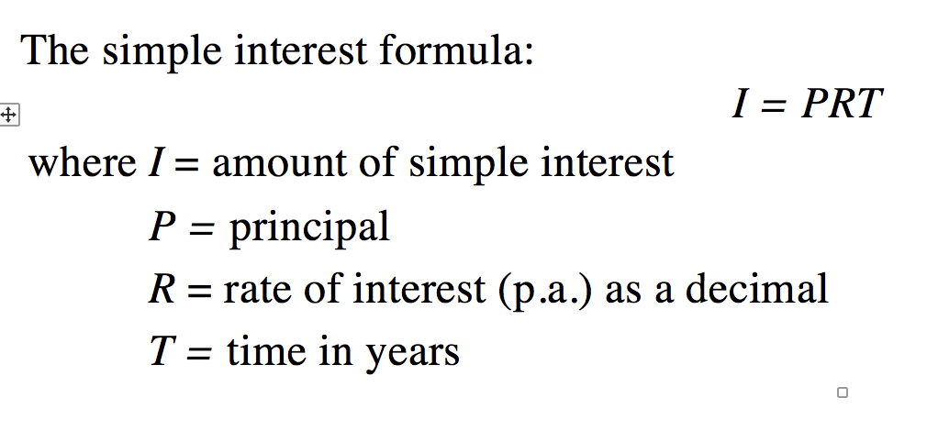
24
7
30
Date
Histograms
EQ – How does Compound Interest differ from Simple Interest?
What simple interest?
When dealing with financial calculations we often want to know the total amount that needs to be repaid by us, or paid to us, at the end of the contract. In the case of simple interest, the total amount is the sum of the principal and the interest.
How is simple interest Calculated?
Simple interest is calculated on the original principal. The simple interest (I) depends on three things: the principal (P), the interest rate per annum (R), and the time in years (T).
The formula used for Calculating Simple interest is:

Slide 11
24
7
30
Date
Histograms
EQ – How does Compound Interest differ from Simple Interest?
What simple interest?

